Slide 1
Classes and Objects

Slide 2
Agenda
Classes in Java
Class Syntax
Example of Class
Objects in Java
Characteristics of Objects in Java
Examples of Objects
Creating Object of Class
Accessing Class Members

Slide 3
Classes in Java
Class is template of an Object.
Class holds functionalities of Objects.
Classes in java contains:
data member
method
constructor
block
class and interface
Example 1: Blueprint of a building.
Example 2: Structure of Organization.

Slide 4
Class syntax
class <class_name>
{
data_member; //field
method;
}

Slide 5
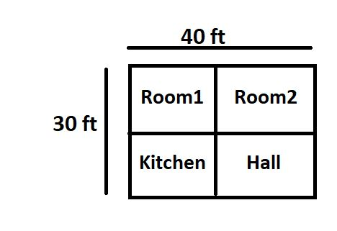
Example Of Class
//creating class is like planning.
// you have to execute plan with functionalities using object, which is like building home.
class Home{
// you can plan functionalities here.
void designBedroom()
{
//code...
}
void designKitchen()
{
//code.
}
}
Home Blueprint (Class)

Slide 6
Objects in Java
Object is an instance or result of class.
An entity or substance that has state and behavior is called object.
Object in real world can be physical or logical (tangible and intangible).
Tangible examples are Car, Bike, Pen, Paper, Phone, Laptop, etc.,
Intangible example is banking system.

Slide 7
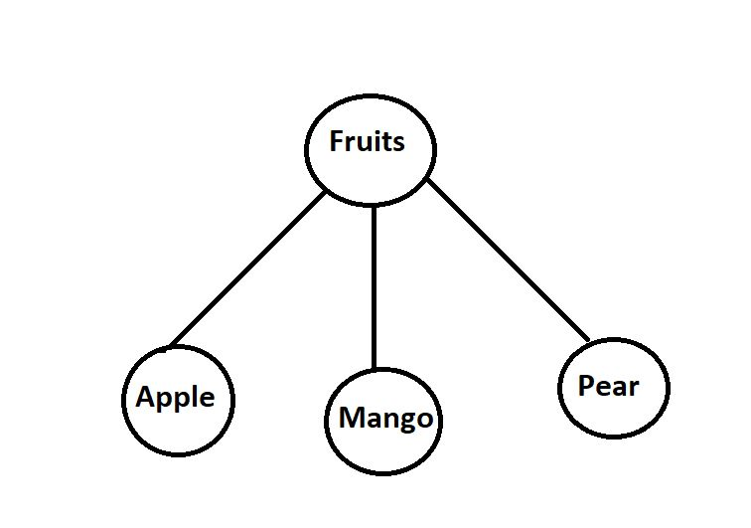
Real World Example
Fruits is a class
Apple, Mango, Pear are objects

Slide 8
Characteristics of Objects in Java
An object in java has three characteristics:
State: indicates data or value of an object.
Behavior: represents behavior or functionality of an object such as cycling, eating, sleeping, etc.
Identity: Every Object in java is typically implemented with a unique ID.
Note : The ID value is not visible to external users, but it is used internally by JVM (Java Virtual Machine) to uniquely identify objects.

Slide 9
Examples of Object
Example → PEN
State:
Object: Pen
pen_Name: Parker
pen_Color: Golden
Behaviour:
Pen behaviour is writing.

Slide 10
Creating Object of Class
class Home
{
void designBedroom(){
//code...
}
void designKitchen(){
//code...
}
}
class BuildHome
{
public static void main(String[] args){
// create object here
Home home= new Home(); //Approach 2
}
}
Creating object
Approach 1:
Student1 s1;
s1=new Student1();
Approach 2:
Student1 s1=new Student1();
.
.
Notes:
Creating an object is also referred to as instantiating an object.
When we declare s1, it points to null.
When we instantiate as given in second line s1 is a reference to Student1.
The method Student1() is the default constructor of the class.

Slide 11
Accessing Class Members
class Home {
void designBedroom(){
//code...
}
void designKitchen(){
//code...
}
}
class BuildHome {
public static void main(String[] args){
// create object here
Home home= new Home();
// Access class members here or Execute plan here
home.designBedroom();
home.designKitchen();
}
}
Accessing Class Members:
Object and dot operator
Objectname.variableName=value;
Objectname.methodName(parameterList);
Notes:
Creating an object is also referred to as instantiating an object.
When we declare s1, it points to null.
When we instantiate as given in second line s1 is a reference to Student1.
The method Student1() is the default constructor of the class.

Slide 12
Summary
We have learned about Classes and Objects in detail along with examples and syntax.
We have also seen how to access class members using object.

Slide 13
Thank You
Proprietary content. ©Great Learning. All Rights Reserved. Unauthorized use or distribution prohibited

